Slide 1

"MOVIE RECOMMENDATION ENGINE“ Enhancing User Experience through Personalized Suggestions
Group 2 Phase 4 Presentation
GROUP MEMBERS:
PATRICIA NGUGI
FAITH MUTISYA
JEFFREY
BRIAN KARIUKI
WAFULA ANDRE
PAMELA OKINYO
ANGELA KALEY

Slide 2
Table of contents
01
02
03
04
05
06
Introduction
Project Overview
Business Problem
Stakeholders
Data Understanding
Dataset Description
Data Exploration
Tags Analysis
Genre Distribution
Ratings Distribution
Modeling Approach
Collaborative Filtering Methods
KNN (User-based and Item-based)
Matrix Factorization (SVD)
Model Evaluation Metrics
Data Preprocessing
Data Cleaning
Feature Engineering
07
08
Model Implementation and Results
Model Training
Performance Comparison
Final Model Selection
Recommendation System Development
User Profile Creation
Movie Ranking Algorithm
Recommendation Generation Process
Handling Cold Start Problem
Top-rated Movies Approach
Most-rated Movies Approach
Initial User Preferences Method
New User Rating System
Conclusion and Future Work
Key Findings
System Limitations
Potential Improvements
Deployment Considerations

Slide 3
PROJECT OVERVIEW
Goal : Develop a recommendation system for a movie streaming platform
Stakeholders: Streaming services and users
Problem Statement: How can we use past user ratings to predict future movie preferences?
Approach: Collaborative filtering (memory-based and model-based)

Slide 4
BUSINESS PROBLEM
Enhance user engagement and satisfaction
Increase watch time and user retention
Provide personalized movie recommendations

Slide 5
THE DATA
Source: MovieLens dataset (ml-latest-small)
Contents:
100,836 ratings
3,683 tag applications
9,742 movies
610 users
Data collected between March 29, 1996 and September 24, 2018

Slide 6
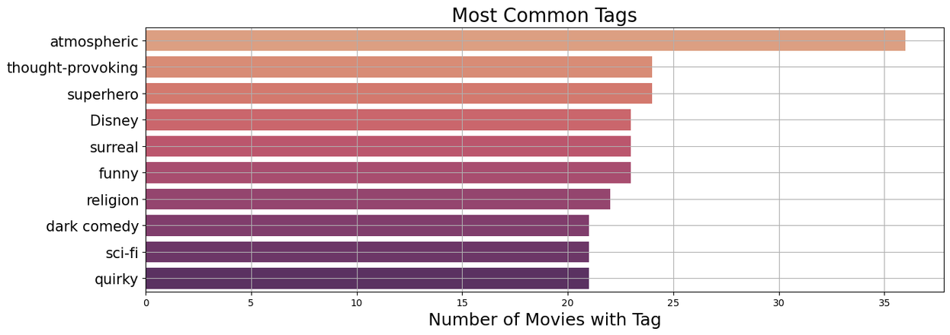
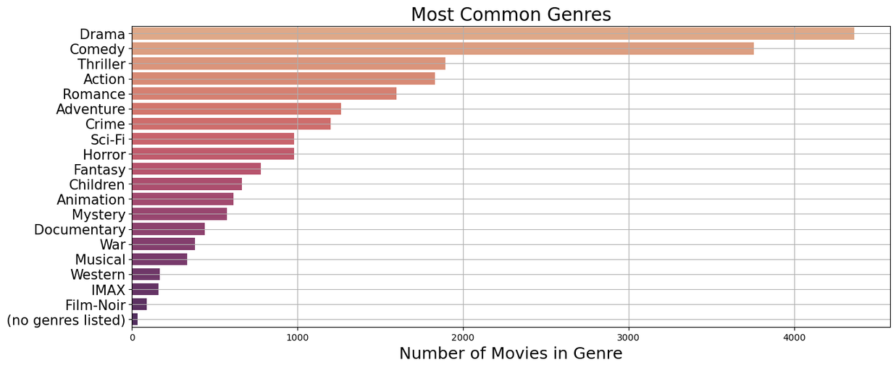
DATA VISUALIZATION
TAGS
Interpretation:
The most common of tags represent a diverse set of descriptors that indicate that there is a wide range of movies that will appeal to many movie preferences.
GENRES
Interpretation:
The most common genres of movies are Drama and Comedy, meaning that those types of movies will be recommended most often. Musical, Western, IMAX, and Film-Noir are less common genres, so those will be rarer amongst the recommendations that we will see.

Slide 7
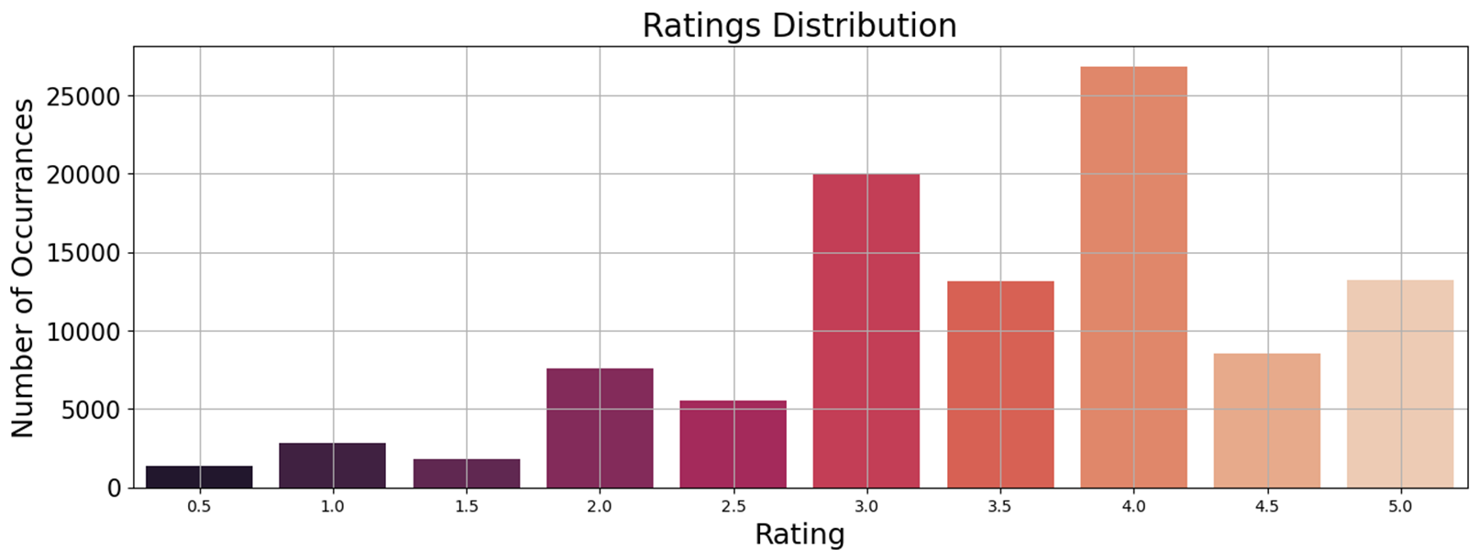
DATA VISUALIZATION
RATINGS
GENRES
Interpretation:
The users in this dataset tend to be generous in their ratings, meaning more movies with high ratings will be available to recommend and will give us a diverse set of movies.

Slide 8

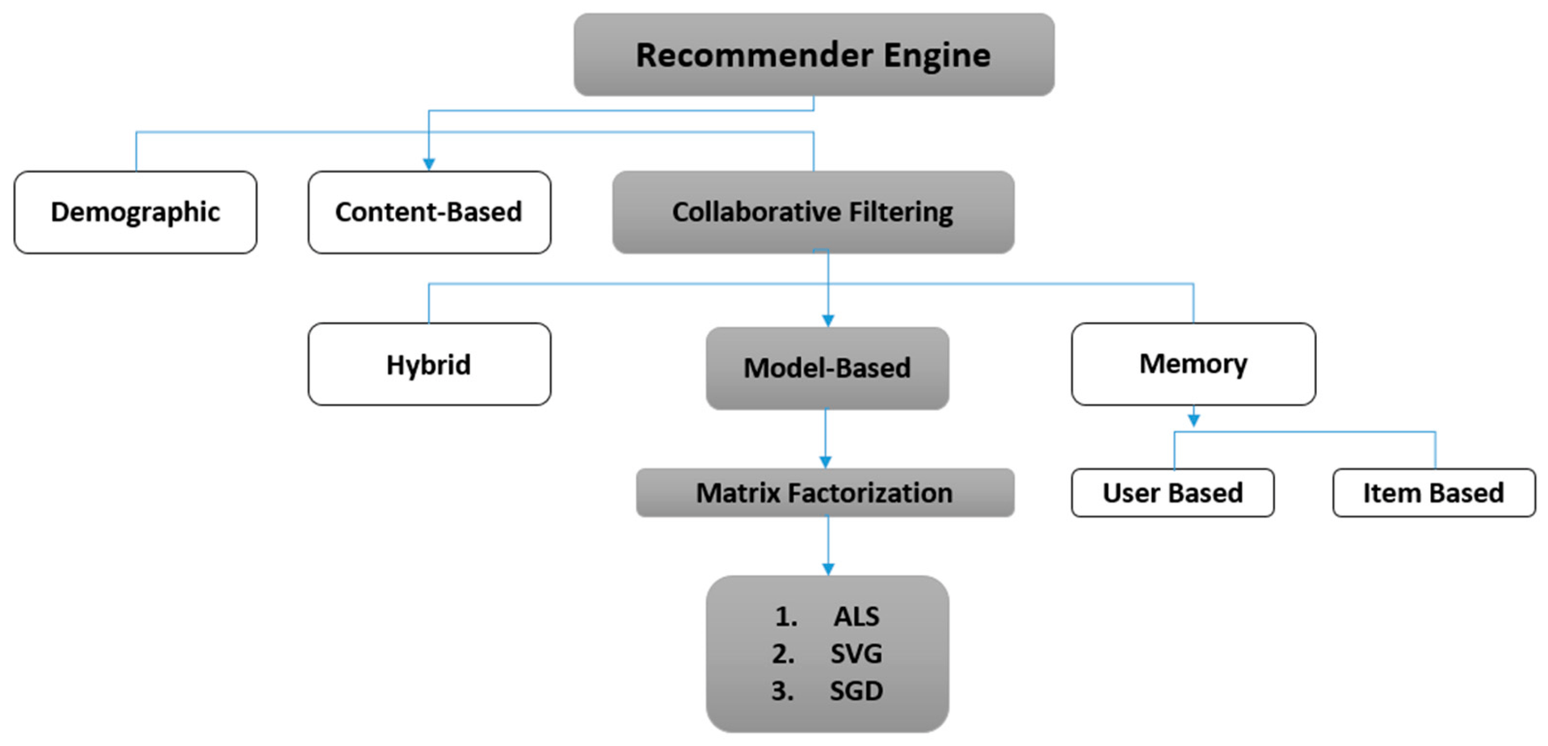
Basics of a Recommender System
A recommender system is an automated system with which to filter some entities. These entities can be any products, ads, people, books, songs, or movies.
These are derived from all platforms daily, from Amazon to Netflix, Pandora, YouTube, and eHarmony.
There are three approaches commonly used by recommender engines; one is content-based filtering, the other is collaborative filtering, and an approach that some of the recommender systems also use is demographic filtering, a mixture of both of these approaches.
Conclusion
This process helps us create a more personalized experience for users by suggesting items they'll likely enjoy.

Slide 9
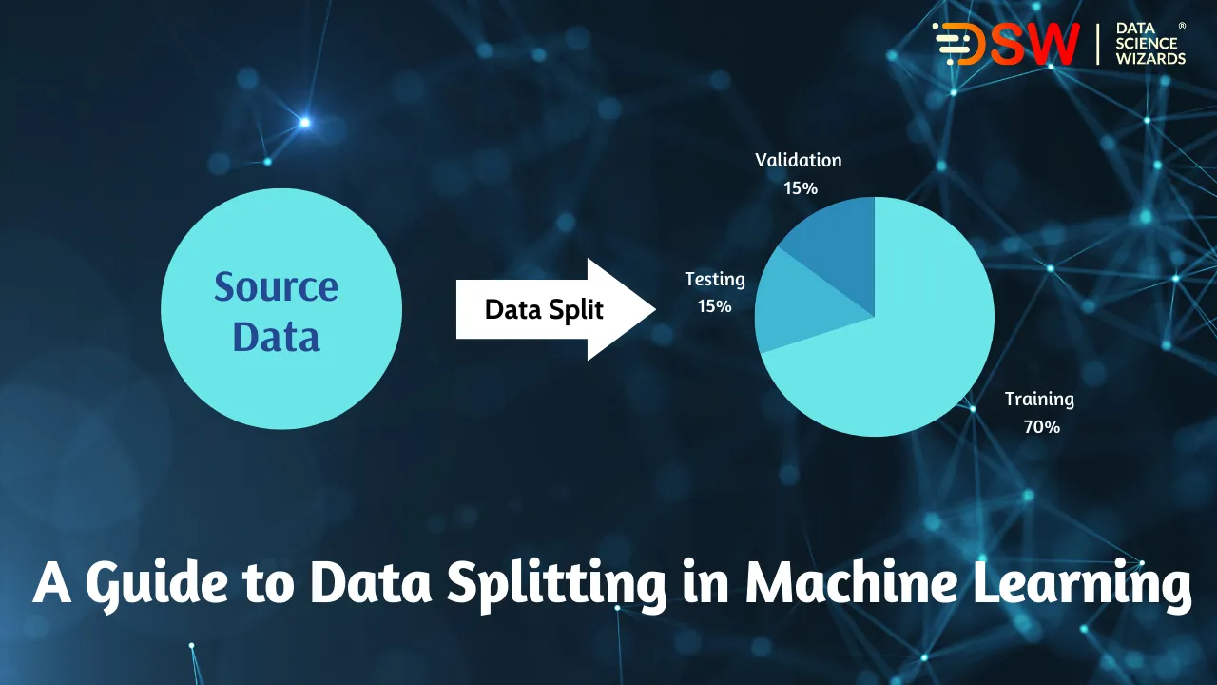
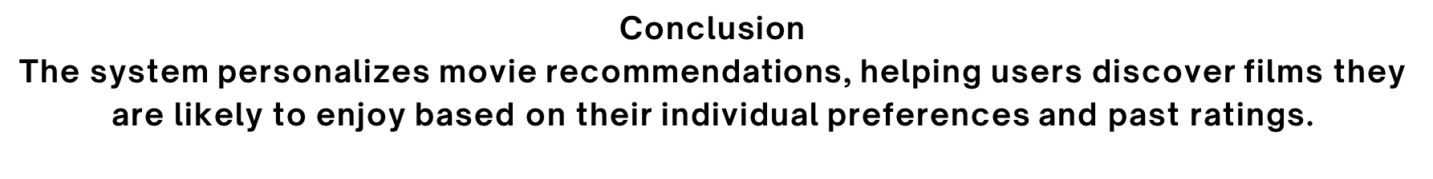
Creating a Surprise Dataset & KNN Model Implementation
1. Data Splitting: We divide movie ratings into training data (to teach the system) and testing data (to evaluate its performance).
2. Similarity Methods: We explore different ways to measure similarities:
Item-Based: Comparing how similar movies are to each other.
User-Based: Comparing user preferences.
3. Model Testing: We try various approaches to identify the most accurate recommendation method, including:
Basic KNN
Baseline KNN
KNN With Means
SVD (Singular Value Decomposition)
4. Model Optimization: Using grid search, we test multiple settings for the SVD method to find the best configuration (80 factors, 0.05 regularization, 10 epochs, 0.01 learning rate).
5. Performance Measurement: We evaluate our model's effectiveness using RMSE (Root Mean Squared Error).
6. User Filters: We create functions to filter recommendations based on user-preferred genres and tags.
7. Recommendations: We rank movies based on predicted ratings and present the top suggestions to users.

Slide 10
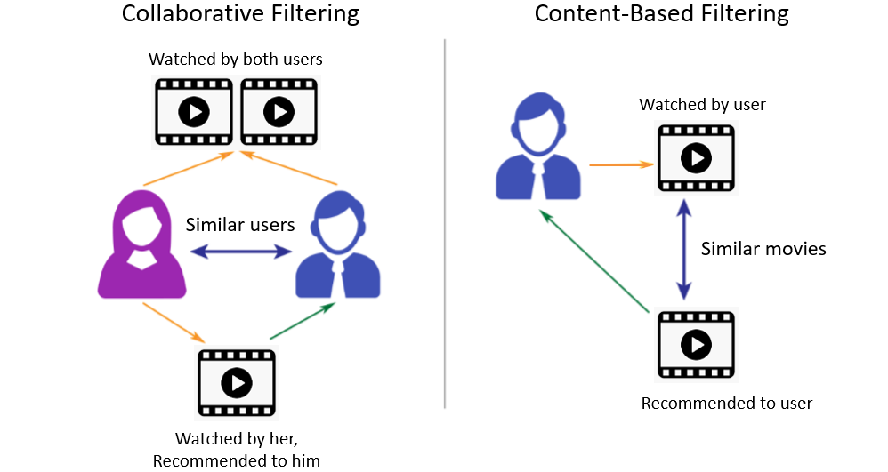
TYPES OF RECOMMENATION SYSTEMS
Content-Based Recommendation System : It is a type of recommendation system which works on the principle of similar content. If a user is watching a movie, then the system will check about other movies of similar content or the same genre of the movie the user is watching. There are various fundamentals attributes that are used to compute the similarity while checking about similar content.
2) Collaborative Filtering : It is considered to be one of the very smart recommender systems that work on the similarity between different users and also items that are widely used as an e-commerce website and also online movie websites. It checks about the taste of similar users and does recommendations.

Slide 11
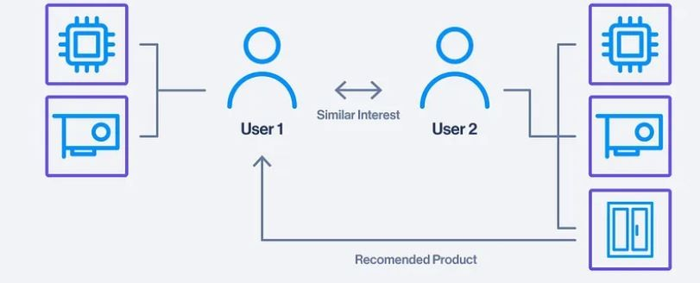
Model Selection and Evaluation
KNN Model Evaluation
Objective: Determine the most accurate KNN model using different methods.
Methods Tested:
KNN Basic
KNN Baseline
KNN With Means
Similarity Measures: Pearson (User & Item) Cosine (User & Item)
Results Overview
Key Results:
KNNBasic: RMSE = 0.9725 (Pearson User)
KNNBaseline: RMSE = 0.8774 (Pearson User)
KNNWithMeans: RMSE = 0.8968 (Pearson User)
Best Performing Model: KNNBaseline with the lowest RMSE.

Slide 12
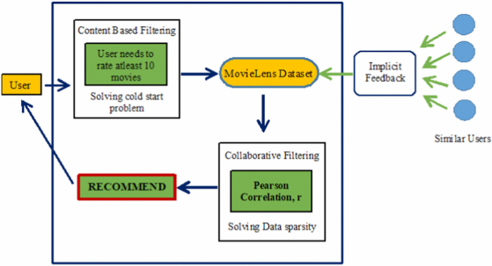
Train and Test SVD Methods
Objective: Perform a grid search to optimize SVD parameters.
Grid Search Parameters: n_factors, reg_all, n_epochs, lr_all
Best Parameters Found:
RMSE: 0.8691465212636365
MAE: 0.667824479485891

Slide 13
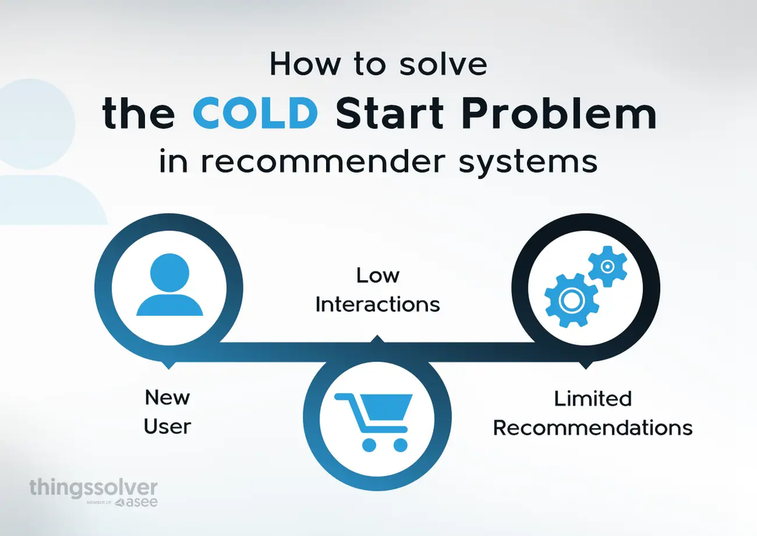
COLD START PROBLEM
How do we recommend movies to a new user?
1. recommend the top 5 highest rated movies
2. recommend the top 5 movies with the highest number of ratings
3. prompt them to choose 3 key words to represent their movie taste upon profile creation
4. give them the option to rank movies they've alreaDy seen

Slide 14
FUNCTIONALITY REVIEW
Functions Used in the Engine
get_ratings_stats(ratings, sortby): Generates statistics on the ratings dataset, including average ratings and total counts.
top_movies(n_movies, ratings): Retrieves a specified number of recommended movie titles.
recommend_by_start_words(start_words): Filters movies based on keywords selected by new users.
user_profile(userId, n): Creates a profile for an individual user to provide tailored recommendations.

Slide 15
FINDINGS
Quality and Popularity Balance: By providing options for both the highest-rated movies and the most rated movies, the engine balances recommending critically acclaimed films as well as popular ones. Movies like The Shawshank Redemption and Forrest Gump appear in both categories, reflecting their high quality and mass appeal.
Handling New Users: The implementation of a cold start solution based on keyword preferences proved effective in creating initial recommendations for new users. Users who entered keywords such as "Adventure," "Comedy," or "Sci-Fi" were provided with relevant and well-rated films. This method helps bridge the gap for new users, enhancing their experience without the need for initial user ratings.
User Profiles and Preferences: By analyzing individual user profiles and movie ratings, the system generates targeted recommendations. This is particularly useful for heavy users, whose ratings distribution and preferred genres can be analyzed to offer highly personalized suggestions. The system’s ability to generate profiles highlights its versatility in catering to diverse user preferences.
Collaborative Filtering Impact: Collaborative filtering worked well for users with significant rating histories. The engine could leverage data from similar users to recommend films that matched the user’s preferences, improving user engagement with the platform.
Limitations: While the engine successfully tackles the cold start problem for new users using keyword-based recommendations, it may still have limitations for niche genres or specific tastes that are underrepresented in the dataset. Additionally, the hybrid approach could be further enhanced with additional contextual data (e.g., user demographics or time of movie viewing).

Slide 16
CONCLUSION
The Movie Recommendation Engine successfully provides personalized movie suggestions by implementing collaborative filtering and addressing the cold start problem. Using the MovieLens dataset, the engine generates recommendations based on user behavior, ratings, and content-based features like movie genres and keywords. By combining collaborative filtering with content-based methods, the system is capable of offering accurate recommendations even for new users with no prior history.
The system includes various recommendation strategies:
Top 5 Highest-Rated Movies: A quality-based approach that recommends movies with the highest average user ratings.
Top 5 Most Rated Movies: A popularity-based approach that recommends movies with the most ratings, ensuring that widely viewed and discussed films are suggested.
Cold Start Handling: For new users, recommendations are based on their selected keywords representing movie tastes (e.g., genres, tags), ensuring they receive personalized recommendations even without historical data.

Slide 17
Future Enhancements:
Hybrid Model Expansion: Future iterations can integrate more content-based features such as movie cast, directors, and reviews to enhance the hybrid approach.
Real-Time User Feedback: Incorporating real-time feedback mechanisms would improve the recommendation system’s ability to adapt dynamically to changes in user preferences.
More Sophisticated Cold Start Solutions: Enhancing the cold start mechanism by gathering additional data during the onboarding process, such as movie clips or trailers watched, could improve early recommendations.
Overall, the Movie Recommendation Engine demonstrates the potential for increasing user engagement and satisfaction by delivering tailored movie recommendations, addressing key challenges like cold starts and balancing between popular and quality content.

Slide 18
Q & A

